Slide 1


Azure High Availability PAAS
and
ARM templates
Bbbb-is-the-word
@4c74356b41

Slide 2
Application Overview
Back-end tier
Azure SQL
Azure SQL Replica
Middle-tier
Azure Queue
Azure Functions
Front-end tier
Azure WebApp (Python + Flask)
Azure Traffic Manager

Slide 3
Infrastructure overview
Traffic Manager
West Europe
East US 2
Load Balancer
Load Balancer
Key Vault
WebApp
WebApp
Storage queue
Functions
Azure SQL database (RW)
Azure SQL database replica (RO)

Slide 4
ARM Template Features

Slide 5
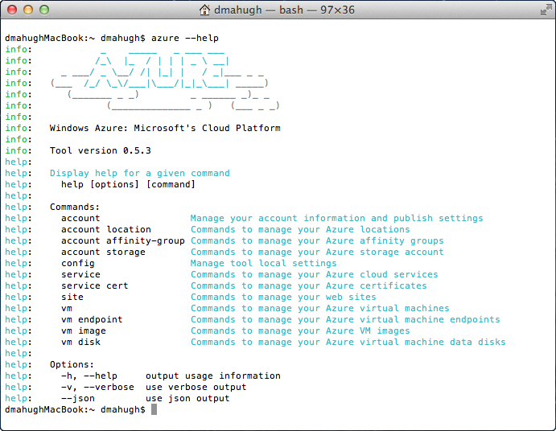
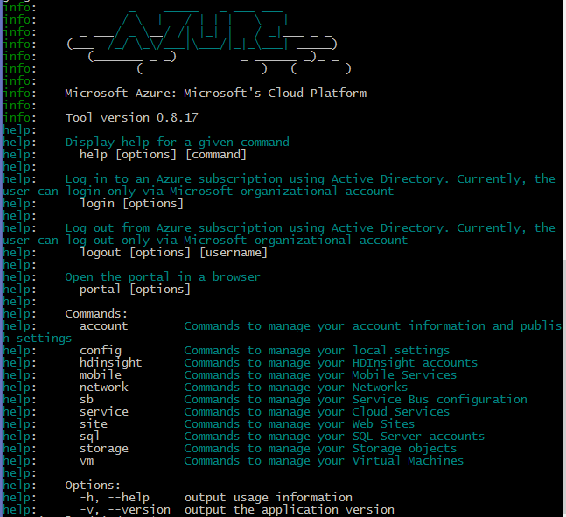
Platform Agnostic, many supported languages

Slide 6
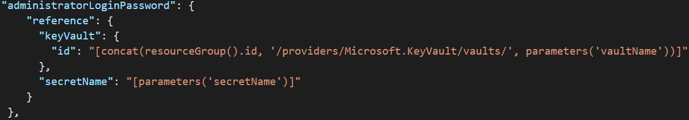
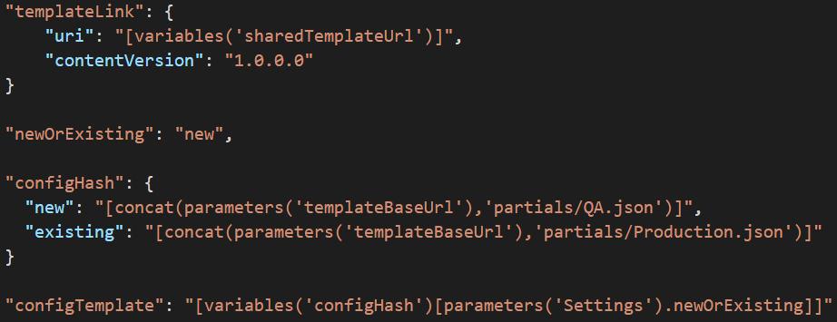
Secure and customizable

Slide 7
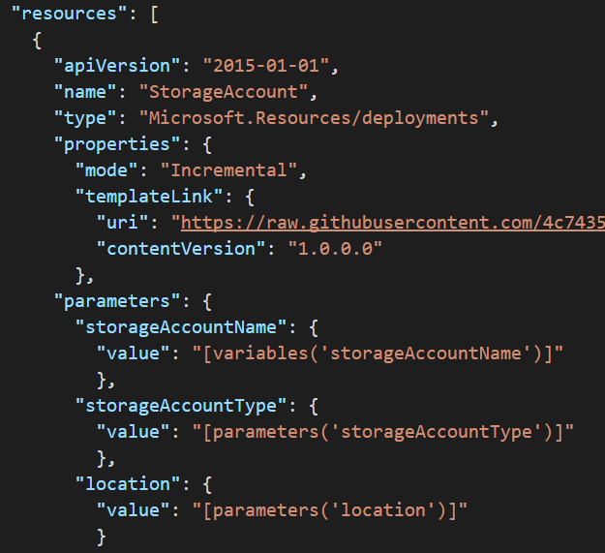
Reusable, idempotent and complex

Slide 8


Jenkins Flow
GitHub
First Job
PowerShell + ARM + Pester
Second Job
Working Production
Profit
Merge into
Master

Slide 9
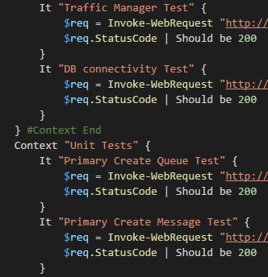
Tests (using Pester)
Sanity
Logic
Integration
Query App endpoints
Create an Azure Queue
Add message to the Azure Queue
Emulate “DB” failure (cripple queue processor)
Add messages to the queue
Verify messages are in the queue

Slide 10
Links
Github of this Demo
#MVA
Deep Dive into Azure Resource Manager Scenatios and Patterns
Building Infrastructure in Azure using Azure Resource Manager
Azure Resource Manager DevOps Jump Start
#Misc
Template Deployment
Deployment Operations and troubleshooting
Resource Policy
Audit Logs
KeyVault + ARM
#Reference
Template functions
Quick Start Templates
Template schema
Explore your deployed resources
ARMClient
Pester

